Slide 1
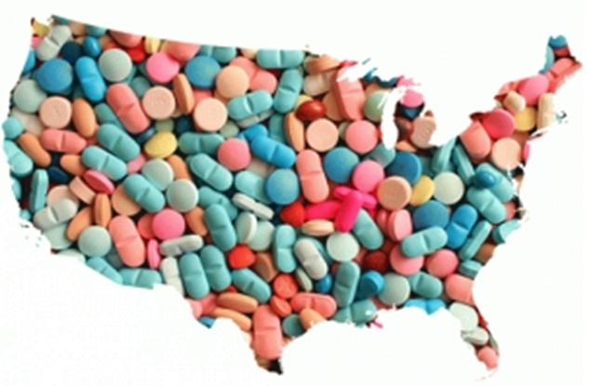
Know the signs, when and how to talk about drugs (opiates)
Speaker: Avi Farah
www.BTFMovement.com
Presentation at TransPerfect
Notes:
[Agenda]
Thank introducer
Thank the bank
Thank attendees
I used to work at Barclay’s
Ben died on May 4, 2013
Started a non profit
3 NYC 3 NJ
Goal
Young Children

Slide 2
Who will benefit from the information
If you plan on having children
If you have young children
If you have teens
If you have elder parents

Slide 3
About Me
My mom was petrified of alcohol
Peggy, my wife, heard stories about her grandmother’s brother / alcoholism
My dad had learning disabilities and sleeping disorder
I have sleeping disorder (hypersomnia)
I have learning disabilities, both dyslexia and ADHD
I have an addictive personality
We knew that Ben had ADHD, sleeping disorder, impulsive and addictive personality

Slide 4
Who’s at risk 14 – 45 / elderly
Addictive personality
Impulsive personality
Learning disability
Sleep disorder
Mental disorder
Family history of addiction/alcoholism or any of the above
Social problems (bullied)
** Early childhood trauma/abuse **
** Live in pain, perceived or actual (physical or emotional) **

Slide 5
What is addiction
Addiction is a chronic disease
One’s need to act despite harmful consequence to one’s well being
Addiction is not limited to substance abuse
Addiction attacks the decision center of our brain
Addiction cannot be controlled with will power
21 yoa is a magic age

Slide 6
Path to opiate addition
Drugs are everywhere and easily accessible
We are more comfortable believing, “It’s not my problem!”
As parents, we all talk to our children about drugs. Infrequently and we tend to exaggerate
Path to drug addiction
Teens will try drugs because they are finding themselves
Economics drive pain killers to heroin and fentanyl
Addiction affects the entire family

Slide 7
Your child starts using
We as parents do not know
If you do find out that your child is using. Be your child best advocate
Be careful not to be an enabler
Your goal is to have your child want to quit using
Make sure that you do not alienate your child
Approaching your child with a negative attitude will not end positively
If you loose a child you need grief counseling

Slide 8
How to talk to our children—Take action
What is the right age to talk to your children? How often?
How to talk to your children—Role play
Role play how your children handle situations: school dance, party, any gathering with no adult present.
Your child is offered a pill or a drink
Your child sees someone who has a blast on drugs
Someone pushes hard on your child a pill or drink.
Discuss the code of conduct among students where a student will not reveal another student

Slide 9
How to talk to our children—Continue
Role play the situation when your child is in pain: after surgery, after an injury like volleyball, baseball, ballet, football, dance, tooth extract etc.
A doctor gives your child (or you) an opiate pain killer prescription.
Suggestion: Agree to rescue your child—role play.
Role play the situation that your child comes home and say: “I messed up I used drugs and I need help”

Slide 10
What to do if your child uses drugs
Drugs, the substance, aren’t the only cause for addiction Isolation, hopelessness and trauma are better predictors of drug use
Naloxone, process of overdosing
Expect your child to be in denial
Recovery is a five years time frame process OR MORE
Find a support group
NA and Nar-Anon (equivalent of AA and Al-Anon)
Protect the rest of your family
Your own sanity
You and your spouse
Other siblings

Slide 11
It is your responsibility to keep yourself and your children safe
Doctors may not know best
Someone who is recovering from addiction may not know best

Slide 12
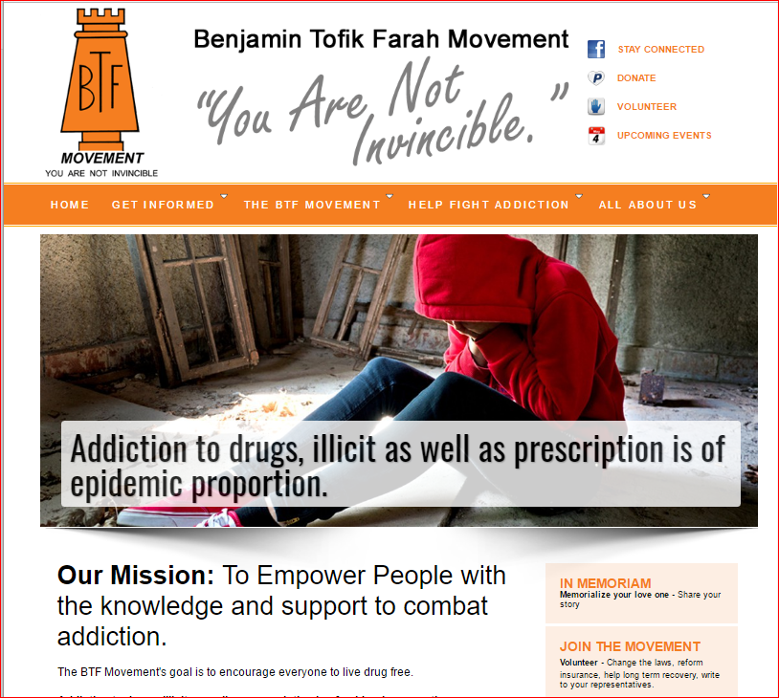
The BTFMovement
www.BTFMovement.com
info@btfmovement.com.
Notes:
[References]
You can contact me though the web site
Tena, Sidney
Volunteer, teen, Sidney was 14
Accurately scale addictiveness
If you know of a town / school I would love to be invited

Slide 13
References
Expert explains why drug overdose deaths soared to record 93,000 amid pandemic (msnbc.com)
Dr. Lee: Pandemic has 'certainly' made opioid crisis worse (msnbc.com)
Dr. Nora Volkow heads the National Institute on Drug Abuse (part of the NIH) her YouTube videos are very informative: Videos of Nora Volkow
Dr. Ruth Potee dr ruth potee – YouTube
https://nextpodcast.transperfect.com/ Grieving podcast by TransPerfect
Book: Under Our Roof: A Son's Battle for Recovery, a Mother's Battle for Her Son. Madeleine Dean, Harry Cunnane. https://www.goodreads.com/book/show/54814836-under-our-roof
Ted Talk: Why do our brains get addicted? https://www.youtube.com/watch?v=Mnd2-al4LCU
Ted Talk: Everything you think you know about addiction is wrong. https://www.youtube.com/watch?v=PY9DcIMGxMs

